Slide 1
Microprocessors, Microcontrollers, and Embedded Systems
CSE 315

Slide 2
Information
Course teachers
A. K. M. Mehedi Hasan Elin – MHE
Md. Emamul Haque Pranta – EHP
Classes
3 lectures per week
First 2 weeks (MHE): Assembly language
Middle 7 weeks (EHP): Microcontroller
Last 5 weeks (MHE): Microprocessor

Slide 3
CSE 316 Outline
Microprocessors, Microcontrollers, and Embedded Systems Sessional
Assignments on assembly language
Assignments on microcontrollers (ATmega32)
Project on embedded systems

Slide 4
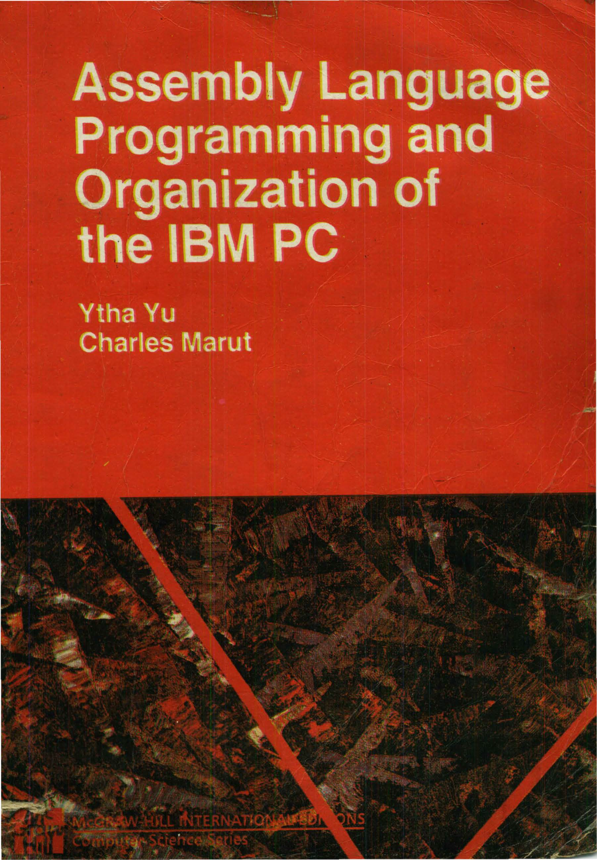
Textbook for Assembly Language

Slide 5
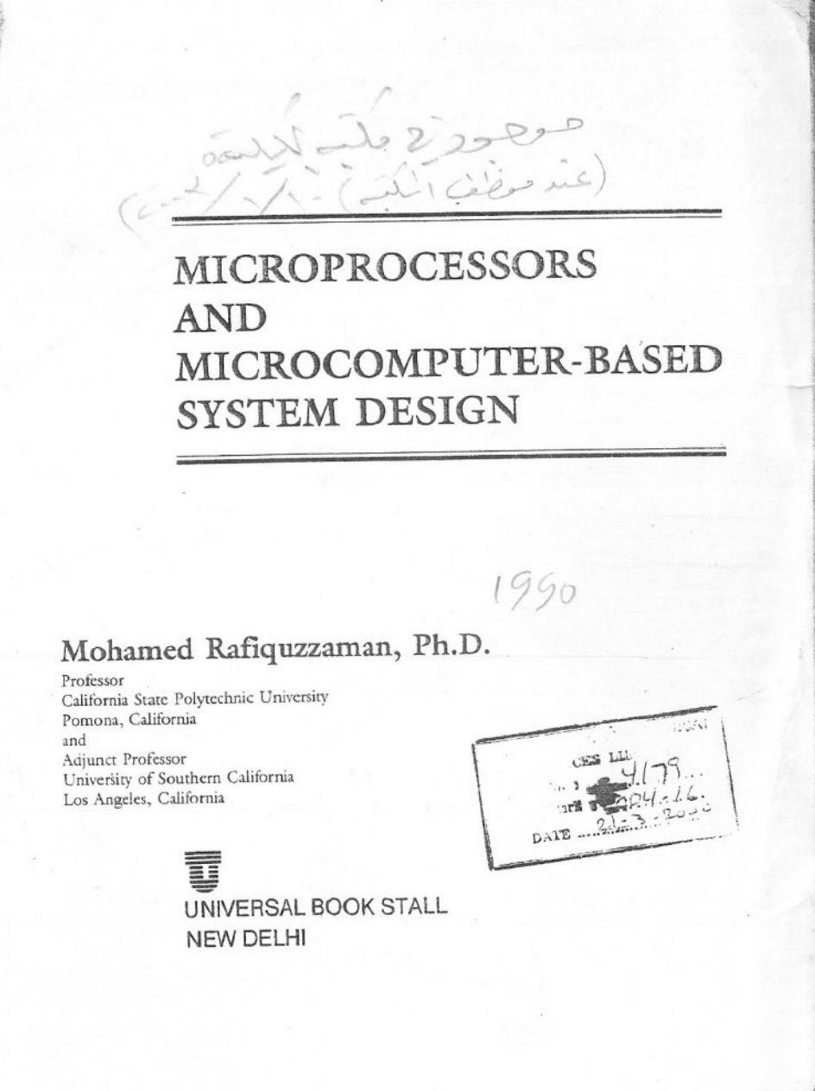
Textbook for Microprocessor

Slide 6
A Typical Computer System Early days
Memory
Central Processor Unit
(CPU)
Input
Output

Slide 7
A Typical Computer System Nowadays
Input
CPU
Memory
Output
Shared BUS

Slide 8
Microprocessor
Microprocessor, by-itself, is completely useless
must have external peripherals to interact with outside
world
CONTROL
µP
ADDRESS
BOOT ROM
Used at startup
Instruction (program) ROM
Transducers
Keyboard Screen UART Parallel interface
etc
Data RAM
DATA
Many chips on mother board

Slide 9
MicroCONTROLLER
µC
CONTROL
ADDRESS
DATA
µP
ROM
RAM
I/O PORTS
BOOT ROM
Used at startup
Instruction (program) ROM
Transducers
UART Parallel interface
Etc
Data RAM
TIMER
Microcontroller – put a limited amount of most commonly used resources “inside” the chip – a “limited” amount is often “enough” for many applications

Slide 10
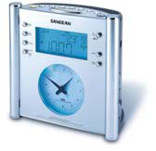
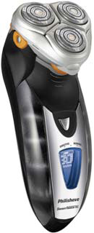
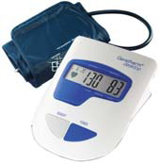
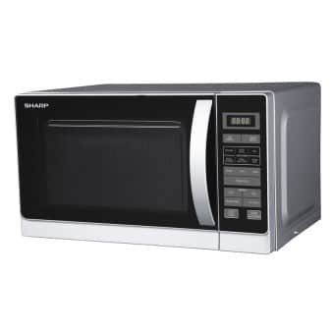
Uses of μC

Slide 11
μP vs μC
 | μP | μC
Structure | CPU | CPU, memory, I/O
Uses | Computer system | Embedded system
Purpose | General | Specific
Cost | High | Low
No. instructions supported | Large | Fewer
Speed | Fast | Slower
Power consumption | High | Low
Architecture | von Neumann | Harvard

Slide 12
Embedded systems
An embedded system is a computer system that has a dedicated function within a larger mechanical or electrical system
Usually based on microcontrollers
Complex ones can have microprocessors too
Examples
Automobiles and airplanes
Medical devices
Home appliances

Slide 13
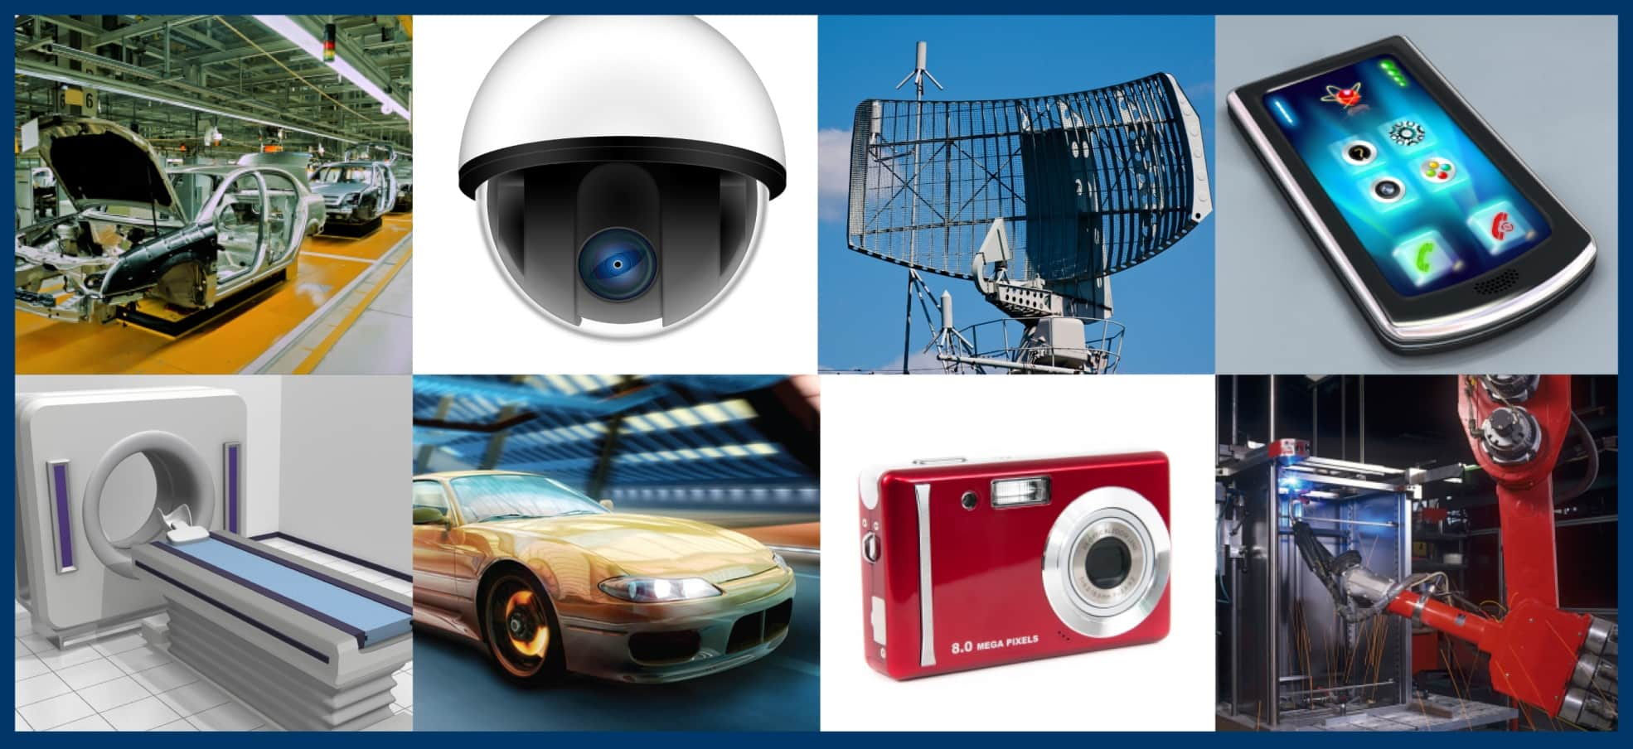
Embedded systems

